Slide 1
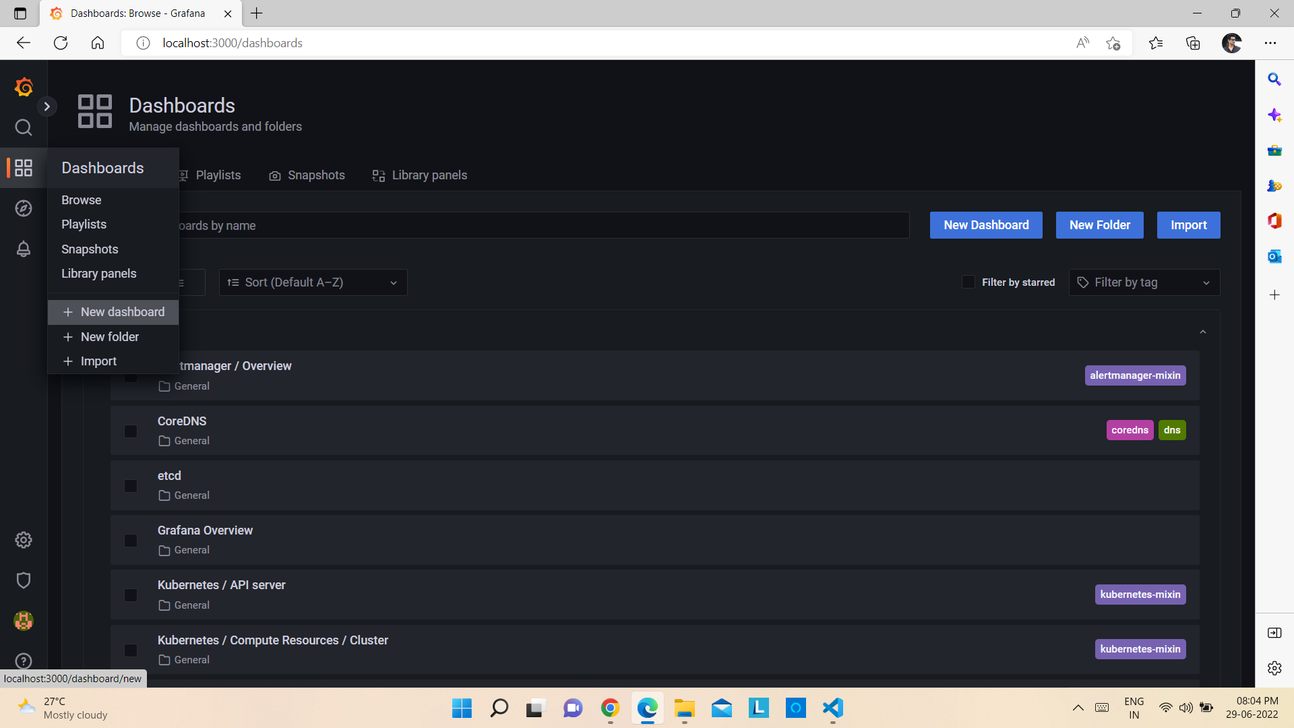
Designing dashboard in Grafana and visualizing deployed sample application CPU and memory status
1) Open Grafana Dashboard and click on Dashboards -> + New Dashboard.

Slide 2
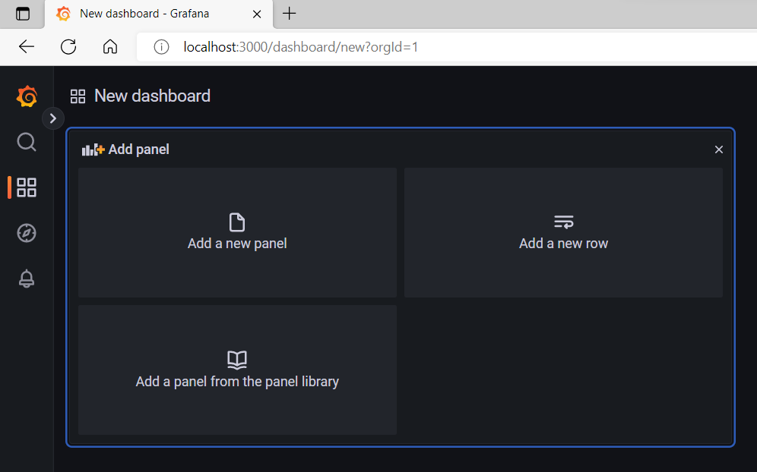
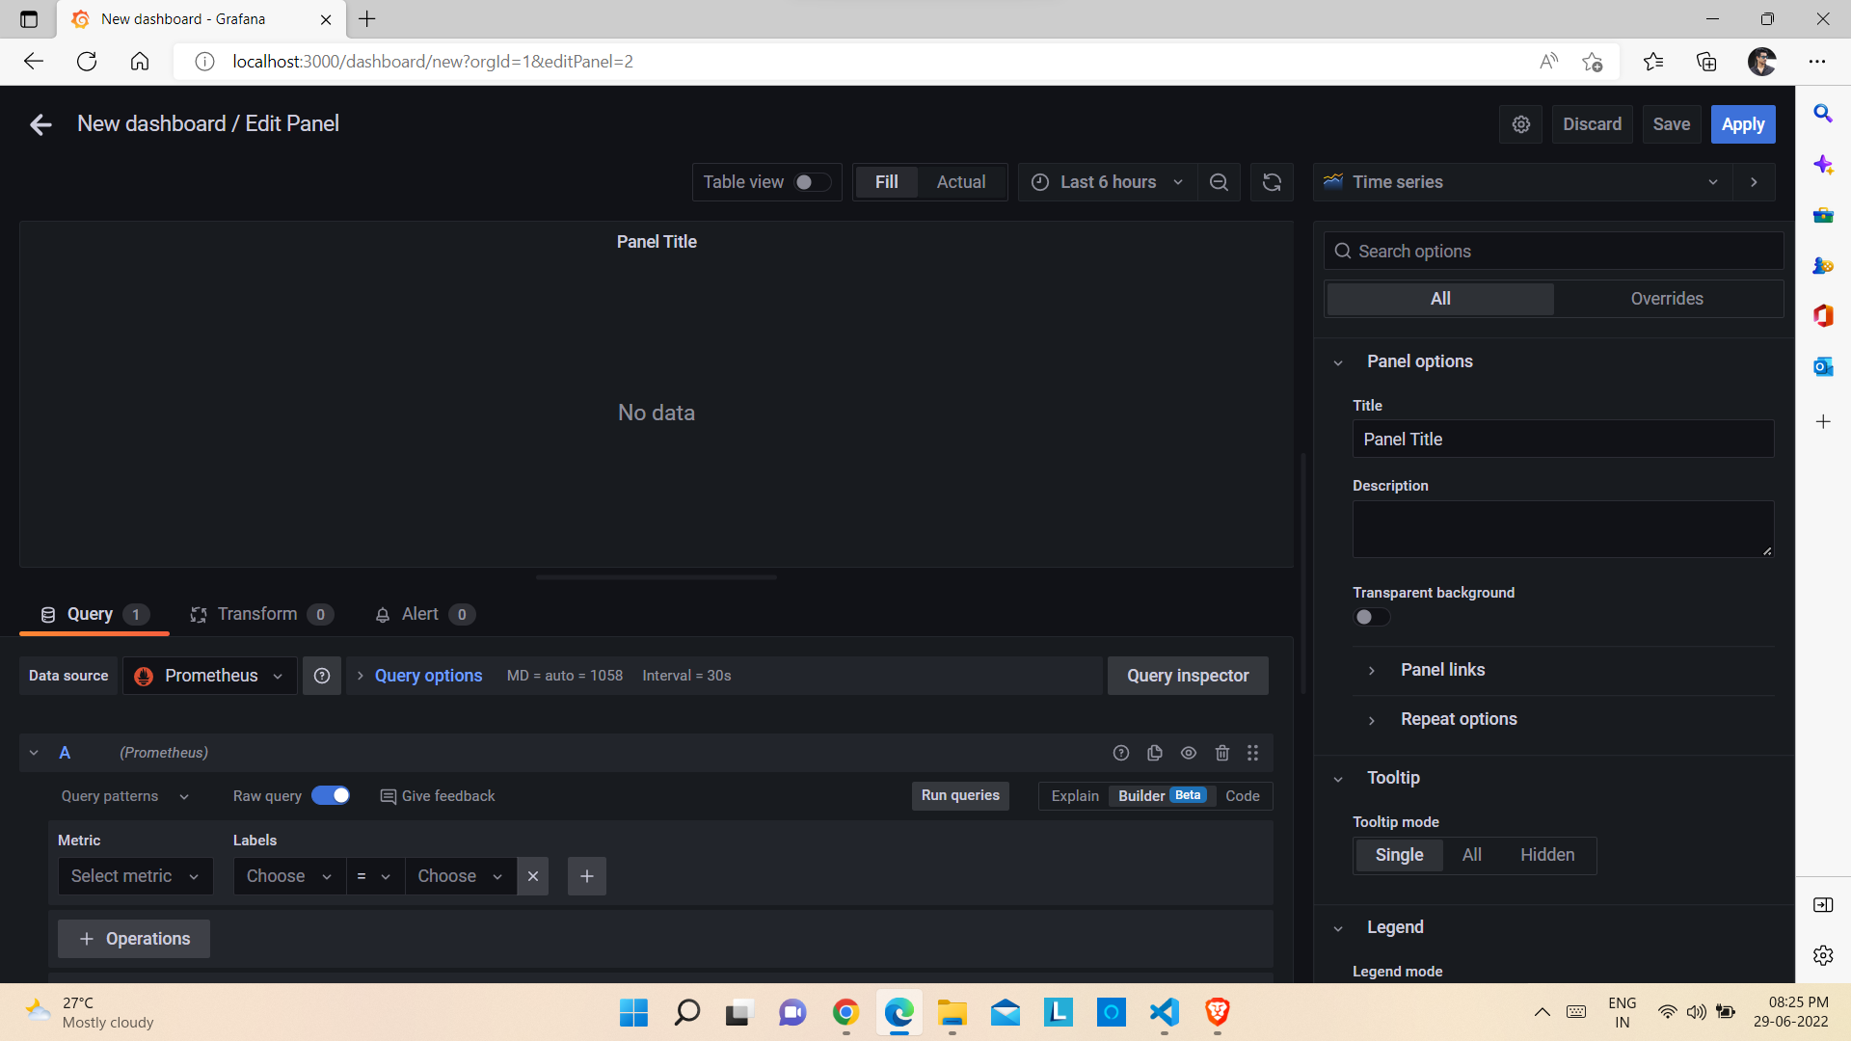
2) After that click on Add a new panel.
3) The Edit Panel window will be opened.

Slide 3
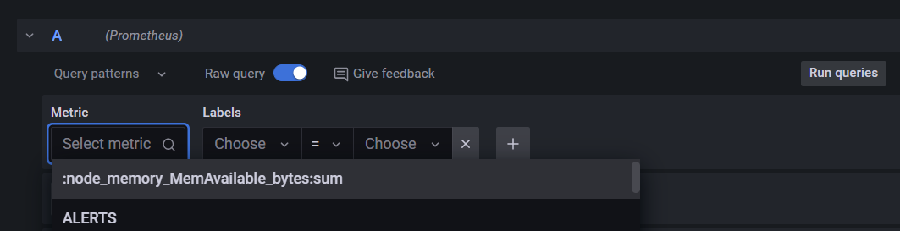
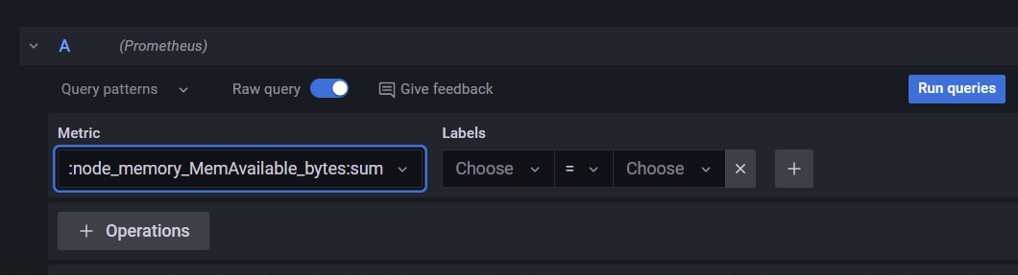
4) Click on Select metric and from the drop down list select node_memory_MemAvailable_bytes:sum and click on Run queries.

Slide 4
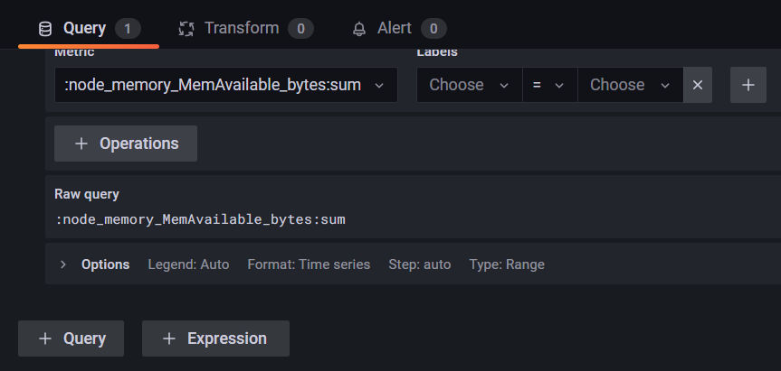
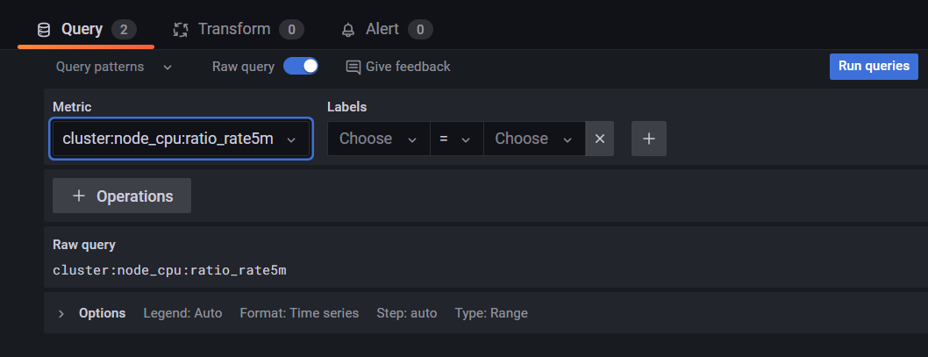
5) Click on + Query to add a new query.
6) Click on Select metric and from the drop down list select cluster:node_cpu:ratio_rate5m and click on Run queries.

Slide 5
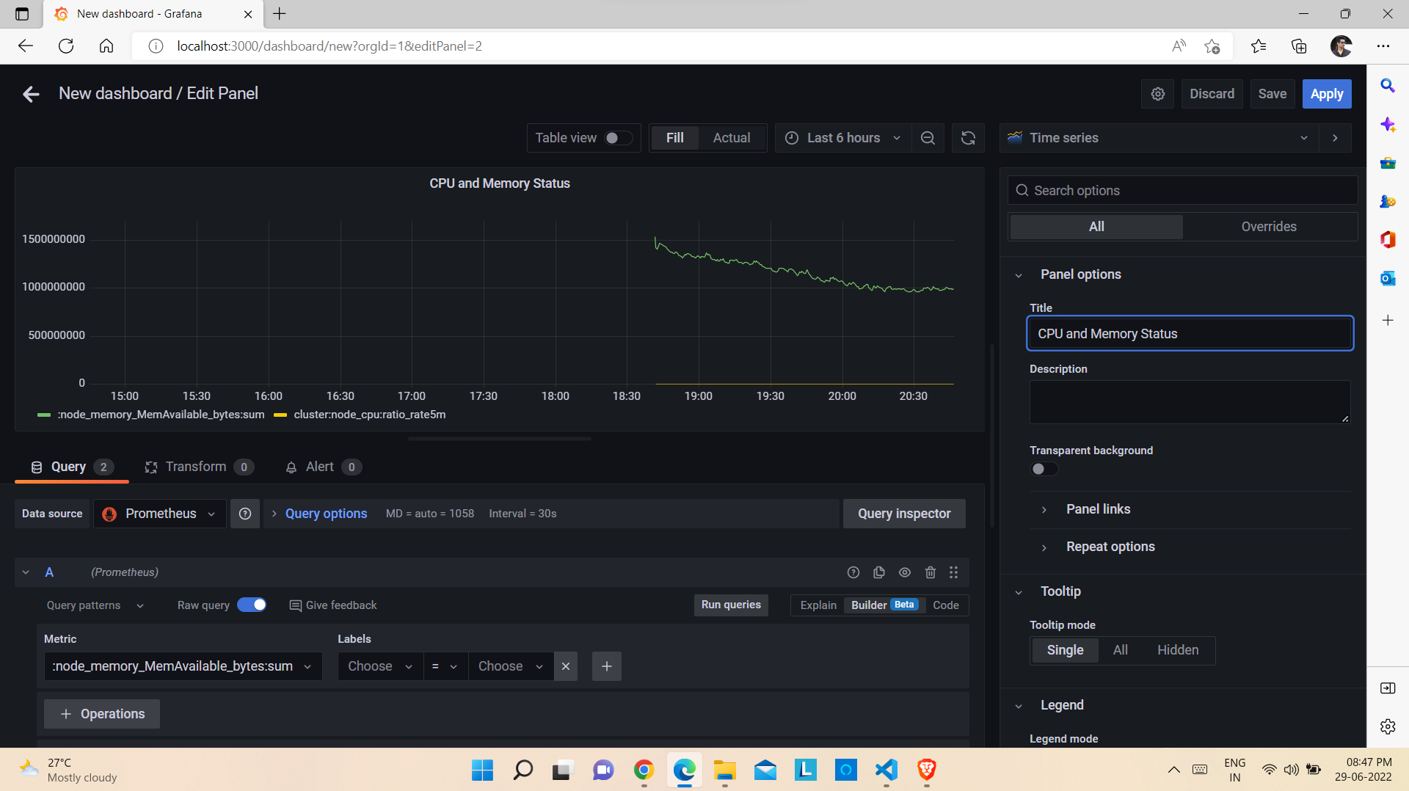
7) Edit the Title and click on Apply.

Slide 6
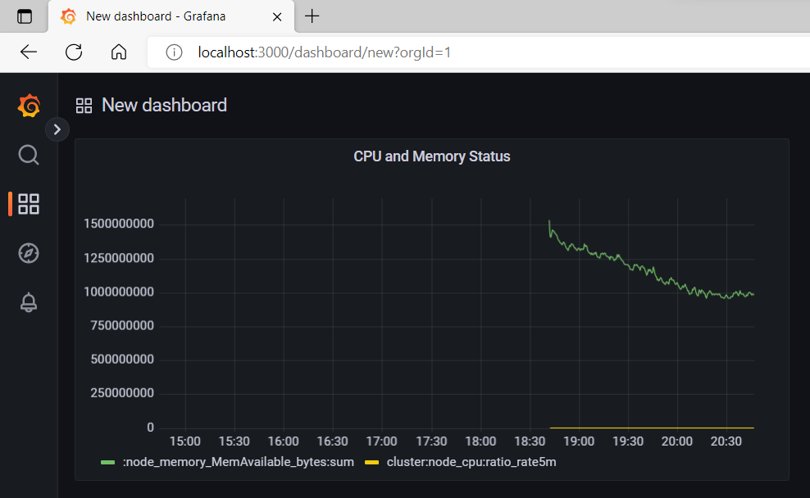
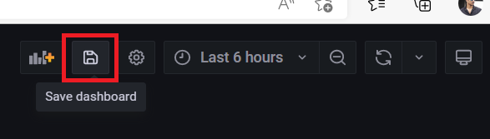
8) The new dashboard will be added.
9) Click on Save button.

Slide 7
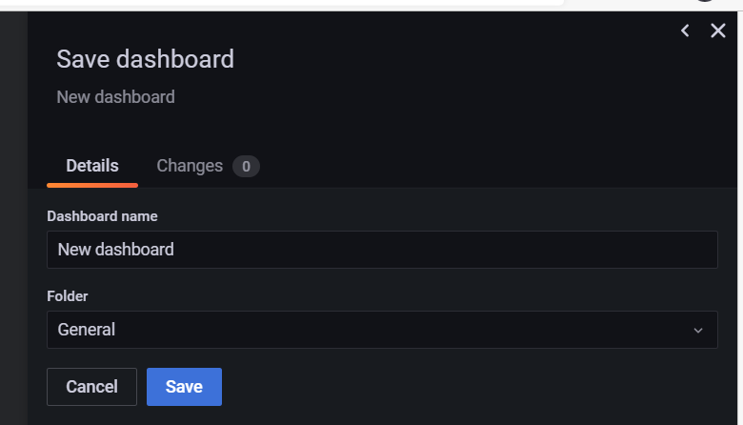
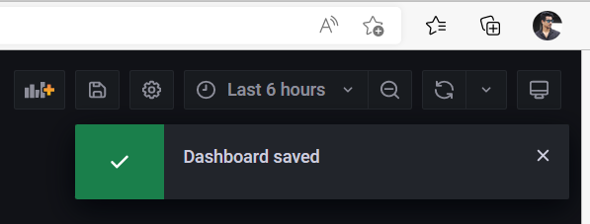
10) Give a name to the dashboard, select the Folder and click on Save to save the dashboard.

Slide 8
Thank you !

